Slide 1
Databricks in a Day
Insight Digitial Innovation

Slide 2
Detailed Schedule
Topic | Time (approx.)
Arrival and Setup | 08:30 – 9:00
Databricks Overview and Interface Walkthrough | 09:00 – 10:00
Break | 10:00 – 10:15
Labs: Read, Transform, and Explore Data | 10:15 – 12:00
Lunch | 12:00 – 01:00
Labs: Power BI (demo) and Machine Learning | 01:00 – 02:30
Break | 02:30 – 02:45
Labs: Structured Streaming and Jobs | 02:45 – 03:30
Closing | 03:30 – 04:00
Notes:
Here’s what the afternoon looks like. The break will come after the interface walkthrough. There will be plenty of time at the end of the session to ask questions and play around in the labs, yourself.
Notes:
Before jumping in, ensure that everyone has their machine up and running and they are settled.

Slide 3




Creating meaningful connections that help businesses run smarter.
Supply Chain Optimization
Cloud & Data Center Transformation
Digital Innovation
Connected Workforce
We help you invest smarter so you can manage today and transform the future.
We create a connected workplace so employees can work smarter.
We help you prepare for the future and align workloads to the right platforms.
We help you innovate smarter so you can make meaningful connections.

Slide 4

In the Dark Ages (1960-2005)
A long, long time ago database systems ran on a single computer with some associated storage
The computers and storage got bigger and faster every year, but the basic architecture remained the same
If you wanted answers faster, you bought a better computer. If you wanted to store more data, you bought a more expensive storage system
If the speed you desired or the amount of data you had exceeded the capacity of the best available hardware, you were out of luck; you simply could not create such a database system.

Slide 5
Hadoop
In 2006, Doug Cutting et al at Yahoo created Hadoop
Unlimited horizontal scaling on cheap computers!
Key ideas…
HDFS, all disks became one file system
MapReduce, a way to run parallel code on all the CPUs
Soon there were Hadoop clusters with 100s of nodes, then 1000s
You could do database things that were simply impossible before!
But there is no free lunch
What were the main drawbacks to Hadoop?

Slide 6
Hadoop Drawbacks
MapReduce is hard to program
A new way of thinking about coding
Does not magically parallelize algorithms for you
Requires trial/error, tuning, multiple stages of MR
Anyone done this?
Hadoop wrote MR intermediate results to disk
Often many times for one job
Much slower than a memory write/read
Hadoop was a “batch” system, not interactive queries
Simple Hive query on small table = ~15 secs

Slide 7
Hive
Introduced in 2009, it solved the "hard to program" problem
SQL abstraction on top of HDFS and MapReduce
Data appears as normal relational-like tables
Database jobs can be written in SQL
Essentially a compiler that translates SQL into Java MapReduce code
Generated code usually better than human would create
But still… lots of disk I/O

Slide 8
Spark
In 2011, Spark project to solve Hadoop disk I/O problem
Goal: Do as many operations as possible completely within memory
Spark delivered 10 – 100x speedup on fewer machines
But alas, still no free lunch
What are the key problems with Spark?

Slide 9
Spark, Issues
Complexity
Hardware clusters
Software installs
File system setup
Performance tuning
Security
Off by default
Can be configured, but hard to do
Enter Databricks (2015)
Notes:
To be fair, I will add a note about Hive… Hive performance has improved steadily since its original version. All phases of the query stack have been speeded up, including far more operations in memory. Hive now claims sub-second queries.

Slide 10
Databricks
Databricks is a way to use Spark more conveniently
Databricks is Spark, but with a GUI and many automated features
Creation and configuration of server clusters
Auto-scaling and shutdown of clusters
Connections to various file systems and formats
Programming interfaces for Python, Scala, SQL, R
Integration with other Azure services
Available only as a cloud service, both Amazon and Azure
The remainder of this workshop will dive in…

Slide 11


What Databricks Provides
Performance
Ease of Use
Collaboration
Notes:
But what happens if instead of having this one laptop to churn through my model, I have all the laptops in this room to share the compute? It’s definitely going to be a lot faster. I could even use 28 of the laptops to run my model, and keep the other two open for email and local data exploration in Excel. That’s distributed computing (Spark in our case), and this is the foundation of Databricks. It provides unparalleled performance for processing large amounts of data.
Now let’s say I don’t actually need all 30 computers to have good performance. Maybe I only need 15. I’m not completely sure, but I definitely don’t want to use more than I need, because if I do, I’ll have to pay for it. I also want to make sure that when I’m done running my model, all those extra laptops shut-down. I don’t want to pay for more than I need.

Slide 12
Databricks Features We’ll Explore Today
Interactive Notebooks
Delta Tables
One-click visualizations
Spark MLLib
Structured Streaming
Power BI Integration
MLFlow
Jobs
Notes:
When you select a tool for data science, you should be thinking about the type of collaboration you will be carrying out.
For example, some teams have several technical data scientists coding together in the same environment.
In this case, it’s important to make sure there is clear record of changes that have been made to code or packages – so nothing gets broken as work circulates among teammates.
Other teams may have a collection of data engineers, business analysts, and data scientists all working on different projects in different environments out of necessity.
In this case, it is crucial that teammates don’t alter other teammates’ environments.
In many businesses, there may be a single data scientist or engineer working on a project, with a non-technical manager with read-only requirements to view outcomes of the work.
In this case, a non-technical user needs to be able to navigate both modules of the project within a workspace and peruse the work for insights.

Slide 13

Demo Problem: Discount Optimization
Wear It Well is a web retailer of men’s and women’s clothing.
Data sources will be CSV
Data set 1 = Campaign Details
Data set 2 = Campaign Results
Live campaign data (streaming)
This Photo by Unknown Author is licensed under CC BY-SA
Notes:
Wear it Well is an online retailer of men’s and women’s clothing. They have a goal to increase conversion rates in their website and mobile app, and they have done some testing of different discount amounts (A/B testing) to determine which discount amounts lead to the most conversions and what that translates into in terms of sales revenue.
Over the last couple of months, they’ve been showing randomly, to different users three different discount amounts, either 0, 10, or 15 percent off. They have captured some demographical information about the users as well as whether users presented with these offers bought something and for how much.
Now they want to take that data and use it to predict which discounts lead to the highest likelihood of conversion across different types of users.
The data is currently being maintained by three different teams within the organization, and it’s not been joined together yet, even for reporting. So our task today will be to bring those disparate sources together, working as data engineers to extract, transform, and load that data. Then we’ll put on our analyst hats to answer some questions about the results of our A/B testing campaign, like do certain types of customers respond more favorably to discounts than others, and finally, we’ll work as data scientists to build a predictive model that identifies which discount should be presented to which customers in order to provide the highest likelihood of conversion (aka buying something).

Slide 14
How do I interact with data using Spark?
Languages
PySpark
Scala
Python
R
SQL
Bash/Powershell
Data Objects
DataFrame
Resilient Distributed Dataset (RDD)
Dataset
Notes:
There are a variety of languages that can be used to interact with Spark as well as different data objects that can be used. For today in our course, we will be utilizing PySpark and DataFrames, but know that other options are available from within Databricks if you need them.

Slide 15
A Crash Course in PySpark
Syntax
DataFrame Objects
df = spark.read.<…>
Methods
df.count() or df.select(<column?>)
Transformations
df.select(<column>).filter(<column>)
Actions
df.select(<column>).filter(<column>).count()
Lazy Evaluation
Transformations are not executed until an action is called.
Transformations are executed in the most efficient order.
Actions return a result and transformations only pass instructions.
Notes:
PySpark is the Spark API for Python. It allows us to send instructions to our distributed computing framework in a Python like language. There are a few distinctions between Python and PySpark, because PySpark is optimized for sending instructions that can be processed in parallel.
When you use methods, you’re using distributed computing. You can use Pandas and scikit learn, but you are not using distrubited computing.

Slide 16
Support Data
Supported Sources
Flat Files
Data Lakes
Supported Formats
CSV
Parquet
Schema Options
Inferred
Databases
Data Warehouses
Storage Containers
Event Hubs
Cosmos DB
User-defined
(considerably faster)
TXT
Excel
Default
JSON
Notes:
There are a variety of data sources and formats that are supported in Databricks. During our course today, we’ll be accessing CSV files, but you are definitely not limited to that in Databricks.

Slide 17
How to Access Data
Manual
Direct Access
Mount
Notes:
There are three ways to access data in Databricks.
Manual: You can manually upload files using the Databricks interface. This can be useful if you want to explore a new data set, or a sample of data, before bringing that data set officially into your environment.
Direct Access: You can access data where it sits through a direct read by providing access keys to the system within your code. This method requires that you know the access keys into the system. It is possible to use a feature in Databricks called Secrecy to ‘hide’ these access keys from other system users.
Mount: Mounting data is the final method for connecting today, and it is what we will be using today. When data is mounted in the Databricks File System (DBFS) it is available to all users of your Databricks workspace. This can be a great way to make data accessible to larger groups of users without providing direct access to your source systems.

Slide 18
Databricks Delta?
ACID Transactions
Efficient Upserts
Streaming Capabilities
Schema Enforcement
Data Versioning and Time Travel
Databricks Delta
Notes:
ACID transactions: Serializable isolation levels ensure that readers never see inconsistent data.
Efficient upserts: Fine-grained updates easily handle late coming data and changing records.
High throughput streaming ingestion: Ingest high volume data directly into query tables.
Optimized data layout: Choose a data layout that suits your query patterns; Delta automatically manages the layout to reduce query latency.
Schema enforcement and evolution: Automatically handles schema variations to clean bad records during ingestion.
Data versioning and time travel: Automatically versions your data for easy rollback and lets you time travel to query earlier versions.
Execution engine optimizations: Optimizes operations with nested data types, higher order functions, range and data skew joins.

Slide 19
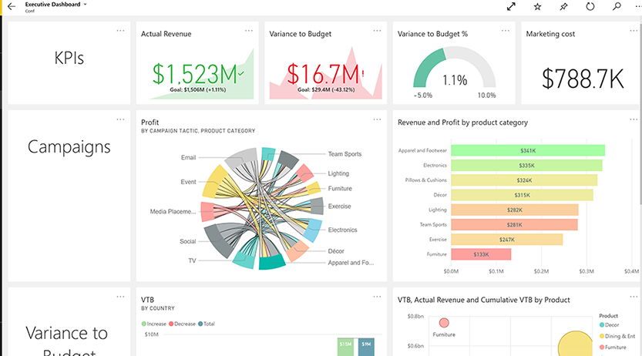
Power BI Integration
Connect to Cluster
Select Datasource
Highly Performant Dashboards
Notes:
Connecting Power BI to one of your Databricks clusters allows you to benefit from both the performance of distributed computing for your reports and directly attach to data sources that have been prepared within the Databricks environment.

Slide 20
Databricks for Machine Learning Enablement
Collaborative Workspace
Performance & Autoscaling
Experimentation & Automation
Notes:
If you have a data science team or have worked with predictive analytics and machine learning yourself, you might be aware of some of the common problems that plague machine learning workflows.
For instance, collaborating effectively with your teammates can be challenging. Especially if you co-develop in various language, on the same pieces of code.
Machine learning, or training algorithms to learn patterns about data, is computationally intensive. While machine learning benefits from cluster computing, data scientists should be spending their time doing machine learning – not managing cluster compute resources.
Finally, machine learning is an iterative process. It requires multiple tries to “get it right” – so data scientists need a framework that fosters experimentation and easy deployment.
Databricks empowers data scientists to do what they do best – solve machine learning problems – without churning on co-development, scaling, and automation issues.

Slide 21
Databricks for Machine Learning Enablement
Collaborative Workspace
Integrated Version Control
Language Support
Environment Management
One-Click Visualizations
Notes:
Version Control
Databricks integrates seamlessly with version control frameworks Git, Bitbucket, and Azure DevOps.
In case members of your technical team are not expert users of Git or version control practices, version control activities can be performed directly in the user interface in Notebook Revision History.
Team members can comment and co-develop in real time (just like Google Docs).
Language Support
Databricks supports Python, Scala, R, SQL, and Bash/Powershell
Within notebooks, you can switch between coding languages
Environment Management
Data scientists can manage environments by managing the libraries installed on their clusters.
They can control which team members can use and edit which environments.
One-Click Visualizations
Data scientists frequently trade an discuss visualization of data during the machine learning process. Typically, these visualization have to be coded in R or Python and are time consuming to edit and clumsy to share.
One click visualizations in Databricks are in-notebook drag-and-drop and exportable visualizations. Everyone who has access to your notebooks can see visualization you’ve created, and may edit/play with them as you do.

Slide 22
Databricks for Machine Learning Enablement
Performance & Autoscaling
Machine Learning Speed
Easy Cluster Setup
Autoscaling & Transparency
Notes:
ML Benefits
Training algorithms in the cloud speeds up arithmetically heavy operations
Easy Cluster Setup
Databricks takes ~5 mins to spin up a cluster
When setting up a cluster, you can specify the compute for your nodes, and a min-max range of how many nodes you think you may need.
You do not have to be precise!
Autoscaling & Transparency
When using cluster computing, you only pay for what you use. Databricks manages scaling your cluster up and down, based on the workload running on the cluster.
You may never need to investigate how Databricks does this – but if you want to, the cluster logs in the Databricks interface allow you that transparency

Slide 23
Databricks for Machine Learning Enablement
Experimentation & Automation
Spark MLlib
MLflow
Jobs
Notes:
Now that we understand how data scientists use the UI and clusters, let’s talk about the experimentation and automation components that give machine learning algorithms legs to run.
Spark MLlib
Databricks supports Spark’s machine learning library, which is a collection of powerful algorithms that are programmed to train in a distributed computing framework.
Mlflow
MLflow is a relatively new addition to the Databricks suite of components. I graduated to public preview in February 2019.
It provides UI for logging parameters, code versions, metrics, and output files
Data scientists can save models and load them with flexibility onto popular cloud platforms.
You can capture model runs from nearly every machine learning library are supported by “flavors” (Tensorflow, PyTorch, Keras, Scikit Learn, Carets)
Jobs
Generally, you can use jobs to automatically run any notebook.
For machine learning, call any model from Mlflow in any notebook – and schedule that notebook as a Job
This enables you to make predictions automatically – which can then be deployed to Azure ML Services, an external API, or write to a data storage account/warehouse/database/lake.

Slide 24
Structured Streaming
Ingest Streaming Data
Create Dataframes
Join, explore, process, and visualize
It’s just another table
Notes:
When working with streaming data in Databricks, Structured Streaming makes it so you can work with that data and create DataFrame objects that can be manipulated like any other table in Databricks. You can perform many of the same operations we have already performed throughout the course, with the data updating in real-time as it changes from in the stream. This streaming data source can then be inserted into a Delta table for access by your analysts, dashboards, and data scientists, allowing for real-time dashboards and predictions.

Slide 25
Caveats / Limitations
Use DataFrames and tables, rather than Datasets and RDD
Use Delta tables when the data might change and you cannot overwrite it.
Databricks not the best as standard ODBC/JBDC query engine
Concurrency on a given cluster is poor
Databricks is great for large data sets, less so for small ones
Azure SQL and MySQL fine for queries on 10M rows, cheaper and faster
Key/value (Couchbase/Redis) much faster for simple lookup, <1ms
Benefit curve…?? Think 1M vs 1B rows
IaaC
Control over resource allocation within Azure

Slide 26
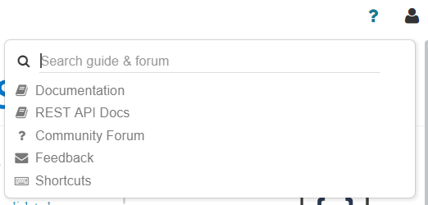
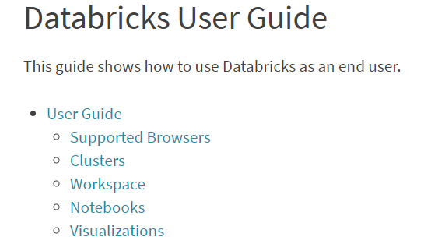
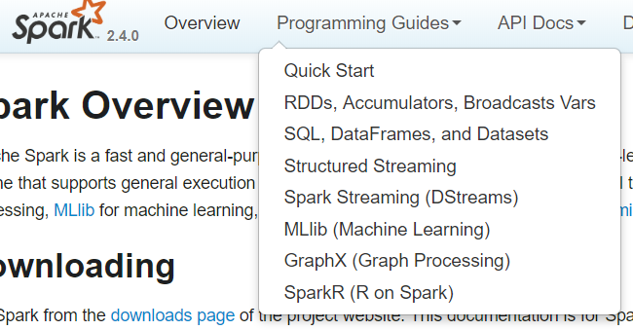
Resources about Apache Spark or Databricks?
The Databricks UI Help Menu & Search
The Databricks Guide
https://docs.databricks.com/user-guide/index.html
Apache Spark Docs
http://spark.apache.org/docs/latest/index.html
Notes:
Databricks comes with a variety of tools to help you learn how to use Databricks and Apache Spark effectively.
Databricks holds the largest collection of Apache Spark documentation available anywhere on the web.
There are two sets of resources that we make available: resources to help you learn how to use Apache Spark and Databricks and resources that you can refer to if you already know the basics. To access these resources at any time, click the question mark button at the top right-hand corner.
The Databricks Guide is the definitive reference for you and your team once you've become accustomed to using and leveraging Apache Spark.
It allows for quick reference of common Databricks and Spark APIs with snippets of sample code.
The Guide also includes a series of tutorials that provide a more guided introduction to a given topic.
The Apache Spark Documentation is also made available for quick and simple search if you need to dive deeper into some of the internals of Apache Spark.

Slide 27
Questions / Comments?

